Slide 1
ScoutsBSA Advancement Changes
Scott Anderson, Chair
National Outdoor Ethics & Conservation Subcommittee
Notes:
The National Outdoor Ethics & Conservation Committee wishes to thank Program Development and the Scouts BSA Committee for the improvements to the Scouts BSA rank advancement requirements.
The Outdoor Ethics & Conservation Committee was charged with examining the continuum of the outdoor ethics advancement programs of Cub Scouts, Scouts BSA, and Venturing. Outdoor ethics is important through all program levels, and on ALL of our outings. Not all of our recommendations were incorporated and some positive changes came directly from the Scouts BSA committee once they understood our goals. In this presentation I will only reference the changes that are improvements to Scouting’s outdoor ethics.

Slide 2
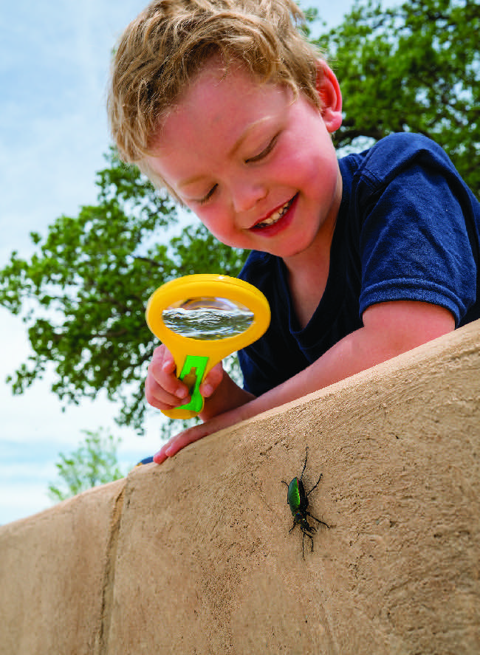
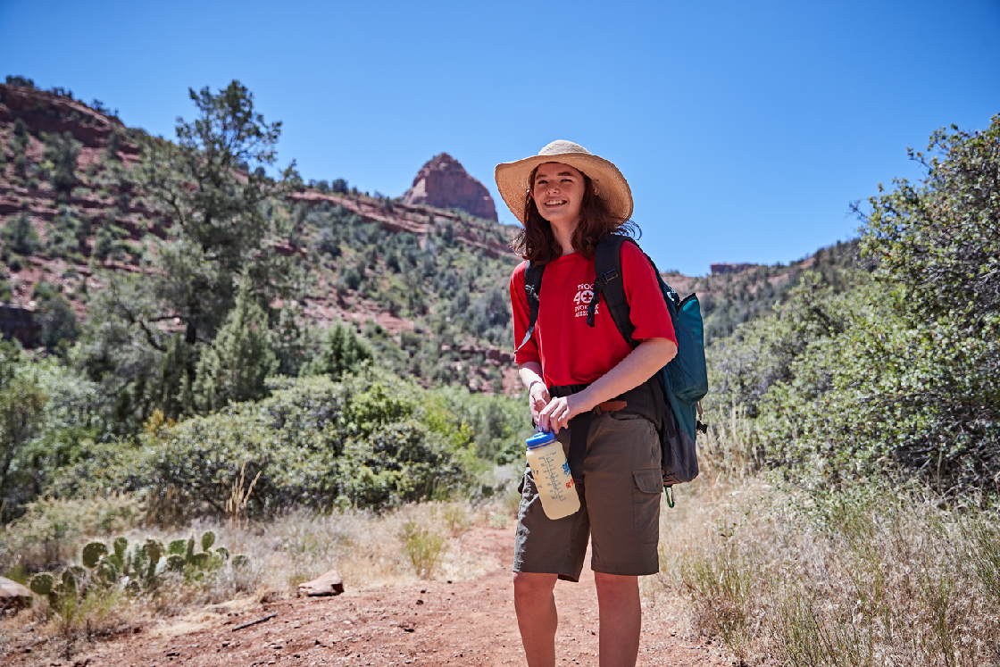
Outdoor Ethics & Conservation
Notes:
It starts with a Lion Cub’s basic respect for animals and nature, and it builds through Cub Scouts, Scouts BSA, and Venturing programs to teach impact awareness, responsible practices and skills, conservation, and stewardship. Key guidance is provided by our Outdoor Code and the Seven Principles of Leave No Trace.

Slide 3
Outdoor Ethics & Conservation
Notes:
The changes were recommended to address the following:
Consistency and continuity across scouting’s programs, and consistency at the Webelos to Scout transition, in particular.
Support the developmental learning progression: hearing, repeating, explaining, doing, understanding, anticipating, teaching, promoting.
Learning the ethical principles and practices while learning the skills. Understanding WHY we do things this way.
Program appropriateness and progression of skills. Be Prepared ‐ Scouts should be taught the practices and skills before they will need to use them.
Developing understanding, respect, responsibility, and stewardship for our outdoors and our environment.
For ScoutsBSA the Scout Handbook and Fieldbook are primary references for our outdoor skills and practices. They provide excellent guidance on outdoor ethics practices consistent with current Leave No Trace best practices.

Slide 4
Outdoor Ethics & Conservation
ScoutsBSA Advancement
Scout Requirement: 1.e
OLD
Repeat from memory the Outdoor Code. In your own words, explain what the Outdoor Code means to you.
NEW
Repeat from memory the Outdoor Code. List the Seven Principles of Leave No Trace. Explain the difference between the two.
Notes:
Responsible use includes not carving trees, damaging property.

Slide 5
Outdoor Ethics & Conservation
ScoutsBSA Advancement
Scout Requirement: 5
OLD
Tell what you need to know about using a pocketknife safely.
NEW
Tell what you need to know about using a pocketknife safely and responsibly
Notes:
Responsible use includes not carving trees, damaging property.

Slide 6
Outdoor Ethics & Conservation
ScoutsBSA Advancement
Tenderfoot Requirement: 1.c
OLD
Tell how you practiced the Outdoor Code on a campout or outing.
NEW
Explain how you demonstrated the Outdoor Code and Leave No Trace on campouts or outings.
Notes:
Puts the OC and LNT on equal footing and adds the premise that you always put them into practice for all outings.

Slide 7
Outdoor Ethics & Conservation
ScoutsBSA Advancement
Tenderfoot Requirement: 5.c
OLD
Explain the rules of safe hiking, both on the highway and cross-country, during the day and at night.
NEW
Explain the rules of safe and responsible hiking, both on the highway and cross-country, during the day and at night.
Notes:
Adds responsible to the discussion. This opens the door to teach traveling on durable surfaces.

Slide 8
Outdoor Ethics & Conservation
ScoutsBSA Advancement
Second Class Requirement: 1.b
OLD
Explain the principles of Leave No Trace and tell how you practiced them on a campout or outing. This outing must be different from the one used for Tenderfoot requirement 1c.
NEW
Recite the principles of Leave No Trace from memory. Explain how you follow them on all outings.
Notes:
Here they are now asked to memorize the Leave No Trace Seven Principles and explain their application on ALL outings

Slide 9
Outdoor Ethics & Conservation
ScoutsBSA Advancement
Second Class Requirement: 2.c
OLD
At an approved outdoor location and time, use the tinder, kindling, and fuel wood from Second Class requirement 2b to demonstrate how to build a fire. Unless prohibited by local fire restrictions, light the fire. After allowing the flames to burn safely for at least two minutes, safely extinguish the flames with minimal impact to the fire site.
Notes:
Here they are now asked to memorize the Leave No Trace Seven Principles and explain their application on ALL outings

Slide 10
Outdoor Ethics & Conservation
ScoutsBSA Advancement
Second Class Requirement: 2.c
NEW
Using a minimum-impact method, and at an approved outdoor location and time, use the tinder, kindling, and fuel wood from Second Class requirement 2b to demonstrate how to build a fire. Unless prohibited by local fire restrictions, light the fire. After allowing the flames to burn safely for at least two minutes, safely extinguish the flames with minimal impact to the fire site. Properly dispose of the ashes and any charred remains.
Notes:
Here we had hoped to reinforce the need to only use an existing fire ring or other minimum impact method to build a fire. It also expands the responsibility of properly cleaning up the remains

Slide 11
Outdoor Ethics & Conservation
ScoutsBSA Advancement
First Class Requirement: 1.b
OLD (Deleted)
First Class: 1b: Explain each of the principles of Tread Lightly! and tell how you practiced them on a campout or outing. This outing must be different from the ones used for Tenderfoot requirement 1c and Second Class requirement 1b.
Notes:
While Tread Lightly! provides an alternate set of outdoor ethics principles, the Leave No Trace principles already provide clearer and more complete relevant guidance for Scout through First Class outdoor skills and ethics. Removing the requirement to learn the Tread Lightly! principles reduces some of the confusion as to what outdoor ethic guidance to follow whenever Scouts are planning and executing their outdoor program.
Tread Lightly! is very important to our Scouting program for specific guidance on motorized activities not covered by Leave No Trace materials. Tread Lightly! promotes outdoor ethics specific to motorized recreation such as all-terrain vehicles and powered watercraft. These are more advanced outdoor programs, that are not universally provided to all Scouts. The Outdoor Ethics & Conservation Committee fully supports and recommends the practice of the Tread Lightly! principles whenever Scouts are participating in motorized recreational activities or backcountry shooting sports. Tread Lightly! provides excellent outdoor ethics teaching resources and education programs and they remain a valued partner of the Boy Scouts of America.

Slide 12
Outdoor Ethics & Conservation
ScoutsBSA Advancement
First Class Requirement: 1.b
NEW
Explain the potential impacts of camping, both on the environment and on other outdoor users. Explain why the Outdoor Code and Leave No Trace principles are important for protecting the outdoors.
Notes:
Instead of learning another set of principles we felt it would be better for the Scouts to reflect on their impacts both to the environment and to the other visitor. while camping.

Slide 13
Outdoor Ethics & Conservation
ScoutsBSA Advancement
First Class Requirement: 2.d
OLD
Demonstrate the procedures to follow in the safe handling and storage of fresh meats, dairy products, eggs, vegetables, and other perishable food products. Show how to properly dispose of camp garbage, cans, plastic containers, and other rubbish.
Notes:
Instead of learning another set of principles we felt it would be better for the Scouts to reflect on their impacts both to the environment and to the other visitor. while camping.

Slide 14
Outdoor Ethics & Conservation
ScoutsBSA Advancement
First Class Requirement: 2.d
NEW
Demonstrate the procedures to follow in the safe handling and storage of fresh meats, dairy products, eggs, vegetables, and other perishable food products. Show how to properly dispose of camp garbage, cans, plastic containers, waste water and other rubbish.
Notes:
Simply adds waste water to the list of items that need to be properly disposed of.

Slide 15
Outdoor Ethics & Conservation
Questions?

